Slide 1
Hospital Management System
Project by: Yameen & Salman

Slide 2
Description:
Hospital management system is an online patient management and Appointment, Scheduler application software for getting an appointment very easily over the internet. This Hospital management system application software is built upon PHP Hospital can take online patient appointment and patient can take doctor schedule from anywhere in the world.

Slide 3
Hospital Main Features :
Online Appointment System
User Level-wise Report
Easy to customize
Doctors Scheduling Management
Patients Management
Bootstrap Based Design
Fresh and Clean Code
Modern Website integration
All Browser Support
Fully Responsive
Billing System is integrated

Slide 4
SOFTWARE & HARDWARE:
Software Used:
Front-end web : PHP,HTML
Back-end :PHPMYADMIN DATABASE
Server: Xampp Server
Component | Minimum requirement
Processor | 64-bit, four-core, 2.5 GHz minimum per core
RAM | 24 GB for developer and evaluation use
Hard disk | 80 GB for installation For production use, you need additional free disk space for day-to-day operations. Add two times as much free space as you have RAM for production environments.

Slide 5
Working Of HMS:
Hospital Management System used index form for the booking of appointment where a patient can enter the details and also can select his own preferred doctor. The form include the all the details also the patient have the option of paying bill later. As the appointment gets booked the data is sent to the database and at the date of appointment the patient is called.
This saves time and paper work for the hospital and keeps an easy record of the patient.
We can add or remove the doctors and we can re schedule the appointments also.

Slide 6
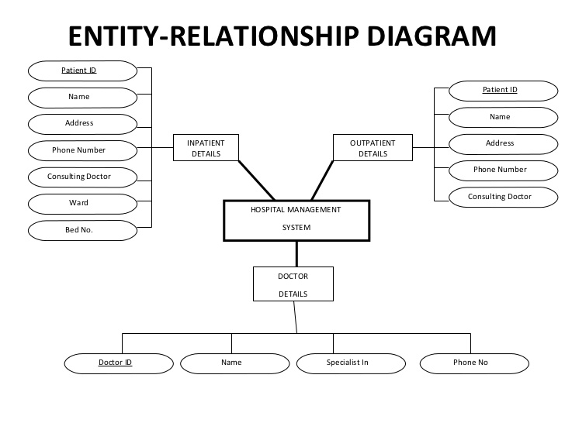
E-R Diagram:

Slide 7
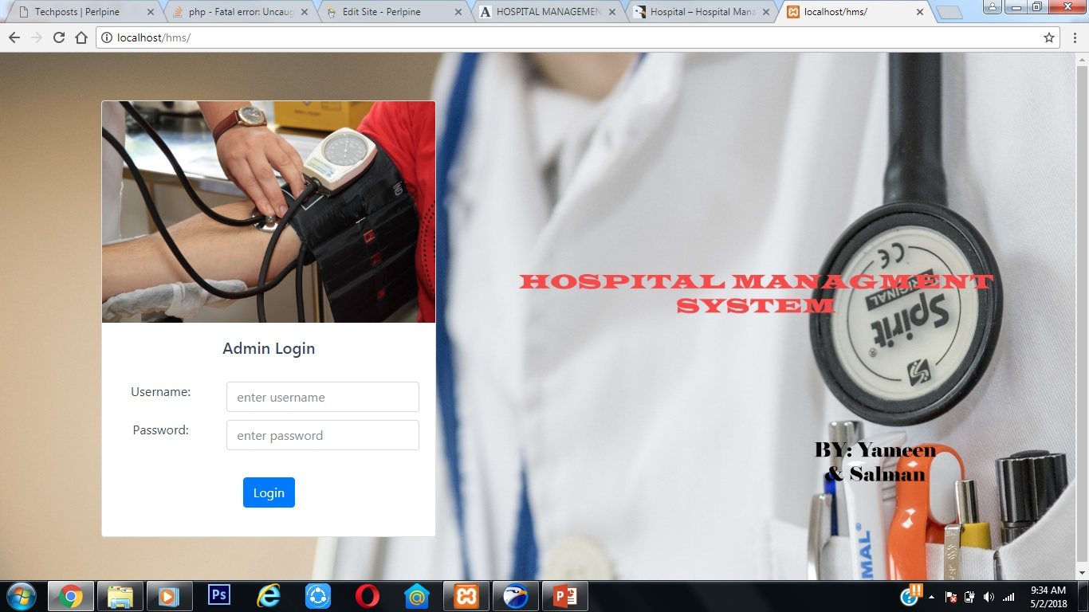
Screenshot of loginpage:

Slide 8
Login Page:
logging in (or logging on or signing in or signing on) is the process by which an individual gains access to a computer system by identifying and authenticating themselves
logon is the procedure used to get access to an operating system or application, usually in a remote computer. Almost always alogon requires that the user have (1) a user ID and (2) a password.

Slide 9
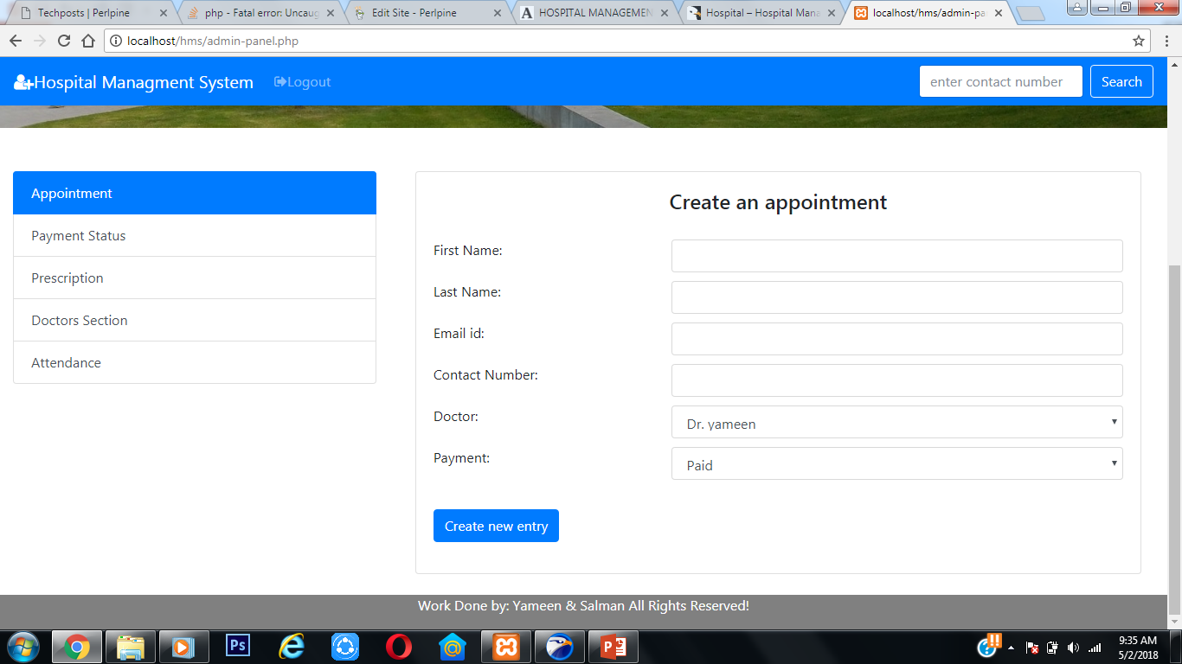
Screenshot of homepage:

Slide 10
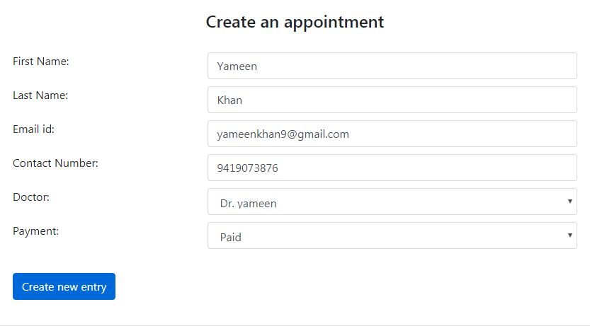
Booking an Appointment:

Slide 11
Appointment page:
This page include the form in which the details of the patient are to written it include the name, address, phone number , preferred doctor.
This page is linked to the database it sends the data to the database and saves it.

Slide 12
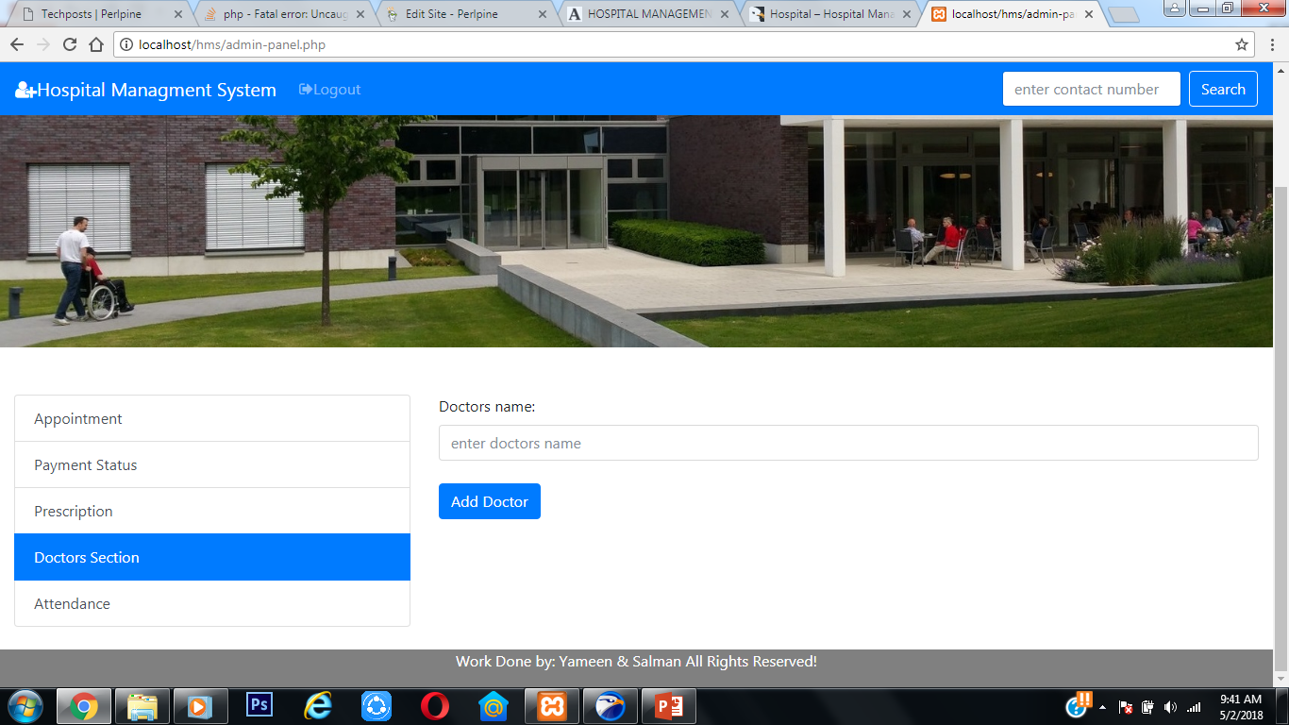
Screenshot of doctor’s section:

Slide 13
Doctors Section:
This section includes the list of the doctors and their schedules³. It also includes doctors’ emergency numbers. The doctor can check his schedule and that of other doctors too. This helps a doctor to edit his schedule accordingly. It includes list of the available medicines for specific diseases so that the doctor can easily look for an alternative when in need. The patient can be given an appointment referring to the doctors’ schedule. The use of HMS makes the co-ordination between a doctor and patient easy and hassle free.

Slide 14
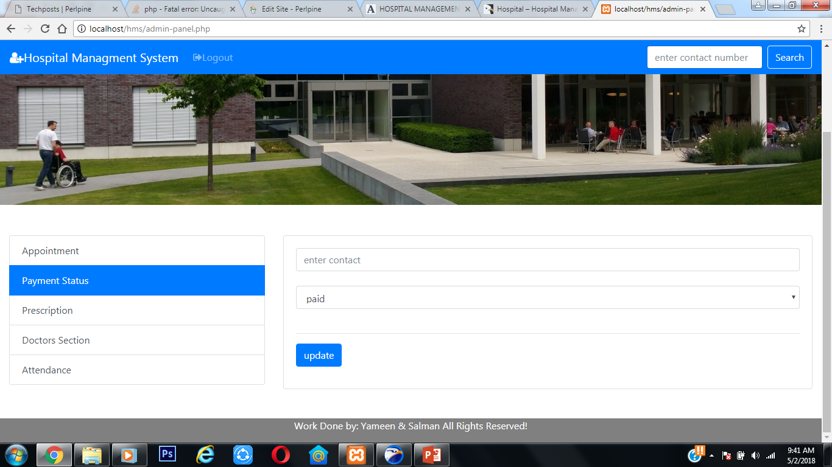
Screenshot of Payment Status:

Slide 15
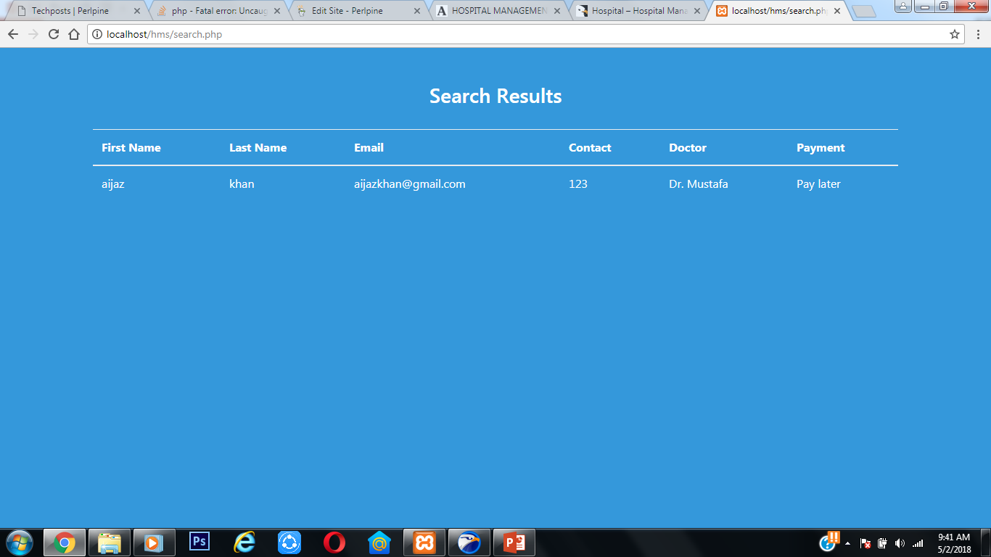
Screenshot of search Appointment:

Slide 16
Payment Update section:
In this section the payment of the patient can be updated by changing it.
It includes two options
1. Paid 2. Paylater

Slide 17
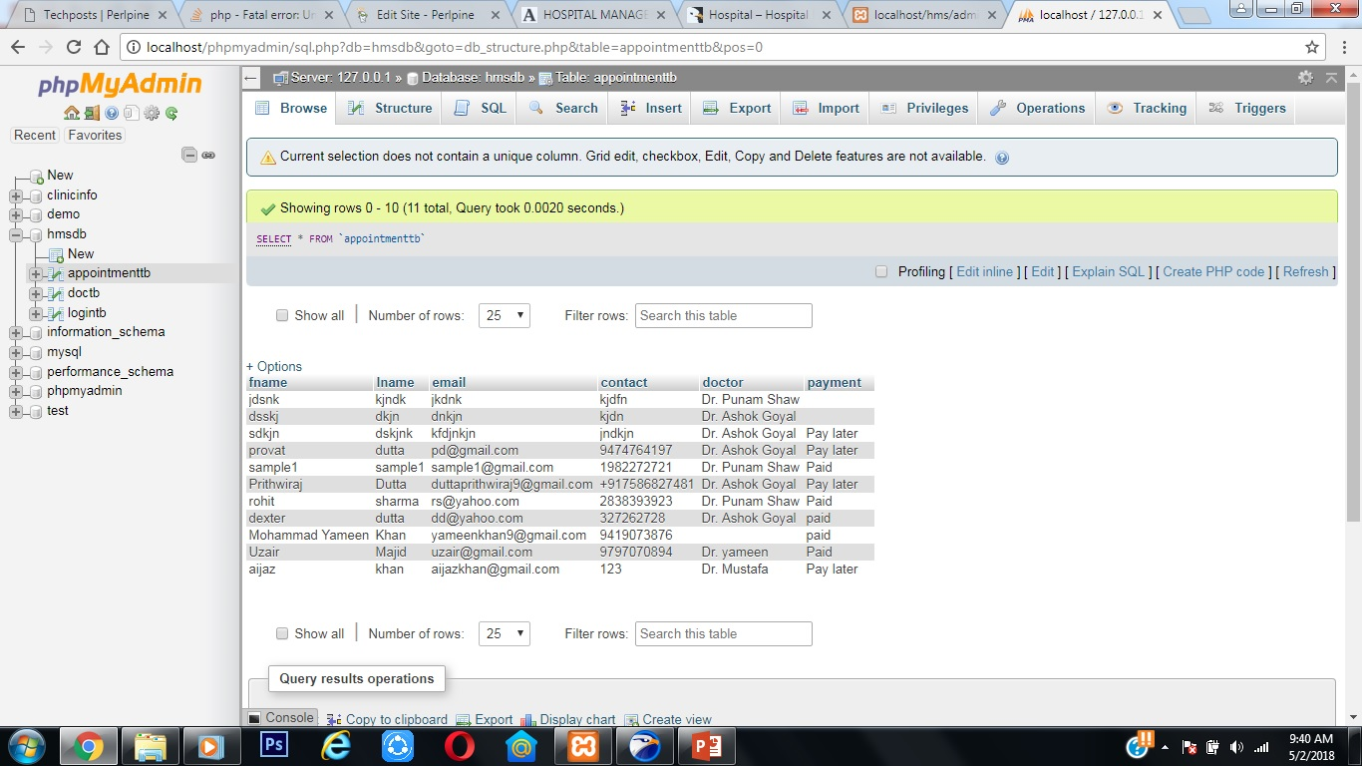
Screenshot of database:

Slide 18
Database:
phpMyAdmin is one of the most popular applications for MySQL database management. It is a free tool written in PHP. Through this software you can create, alter, drop, delete, import and export MySQL database tables. You can run MySQL queries, optimize, repair and check tables, change collation and execute other database management commands.
All the Front-hand information is saved in the database.

Slide 19
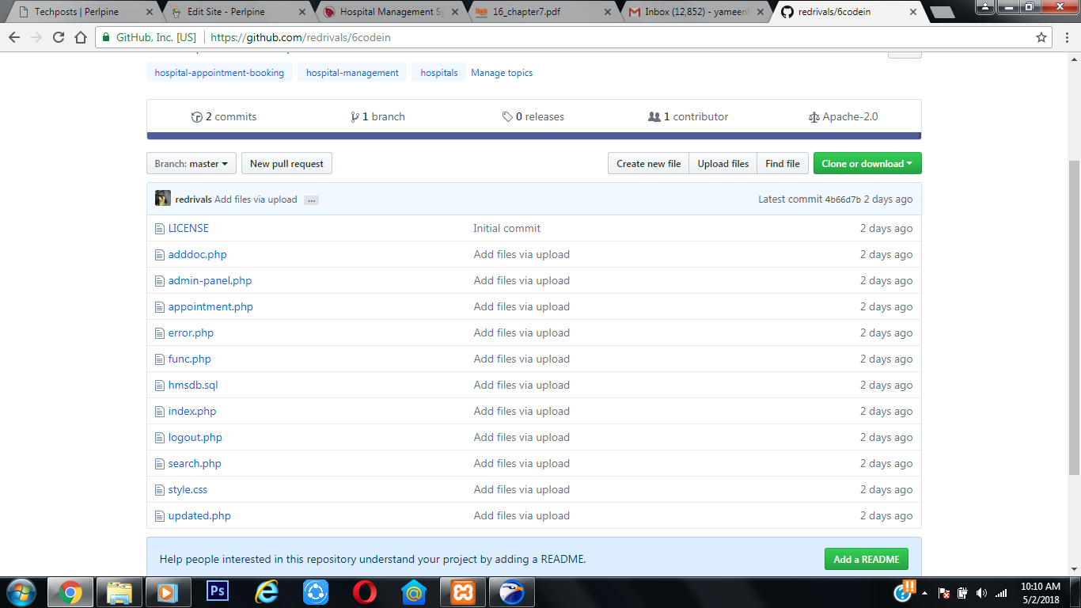
GIT-HUB

Slide 20
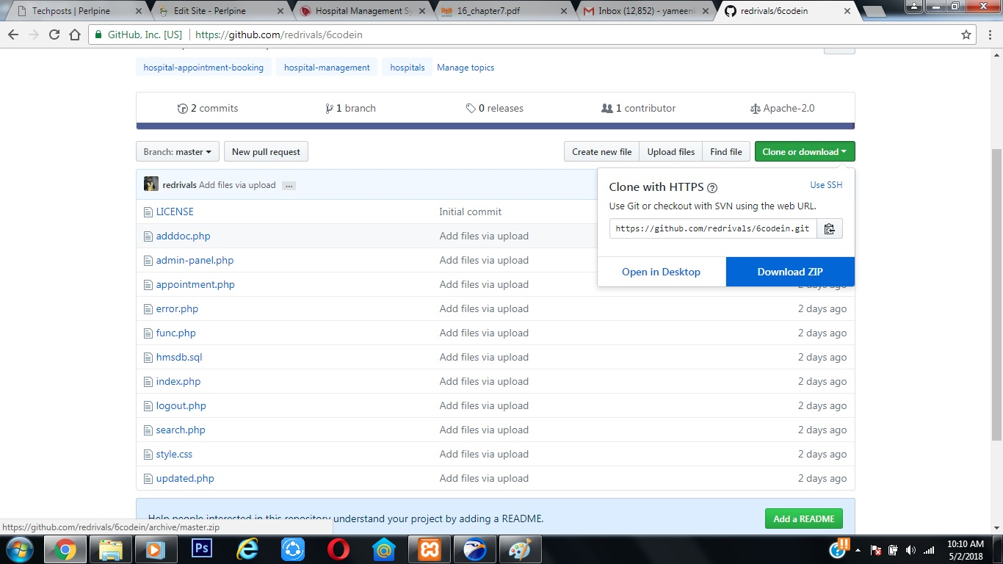
GITHUB DOWNLOAD SECTION:

Slide 21
Conclusion:
The whole systems activities are divided into three major parts like patients, doctors, and admin. Each one has their own role to perform and system respond accordingly. Several agents have been created using web services and inter agent communication is done. For implementing the system technologies like PHP , HTML , SQL, CSS are used. Some parts used HMS concept and works exactly like them. In HMS also xml files are used for managing the states and information.

Slide 22
THANKYOU!

